Slide 1
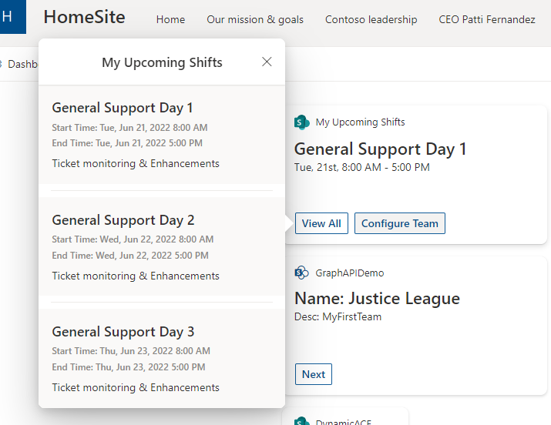

My Shifts Adaptive Card Extension (Viva Connection)
PrimaryTextCard-MyShifts
Siddharth Vaghasia (@siddh_me)

Slide 2





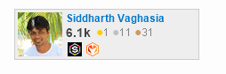





Siddharth Vaghasia
https://siddharthvaghasia.com
https://c-sharpcorner.com/members/siddharth-vaghasia
@siddh_me
siddharth-vaghasia
https://www.linkedin.com/in/siddharthvaghasia

Slide 3

PrimaryTextCard-MyShifts
ACE to show current logged in user’s upcoming shifts based on selected team
https://github.com/pnp/sp-dev-fx-aces/tree/main/samples/PrimaryTextCard-MyShifts

Slide 4
Summary
Display current logged in user’s immediate Upcoming Shifts in card view
Show all upcoming shifts in Quick View
Configurable ACE based on User’s preference(not admin)
Shifts will be displayed from selected team
Storing the User Preference settings in user’s OneDrive
Personalized Experienced in Viva Connection
Configurable option to show Shift title or Date as label

Slide 5
Concepts Explored
Exploring new Adaptive Card Extension
Calling Graph API from ACE
Using Microsoft Graph to store/read user's settings(preference) in application's personal folder of user's OneDrive
Usage of multiple Quick Views
Stage management between views
https://blog.mastykarz.nl/easiest-store-user-settings-microsoft-365-app/

Slide 6
Demo/ Code Walkthrough

Slide 7
THANK YOU

